Slide 1


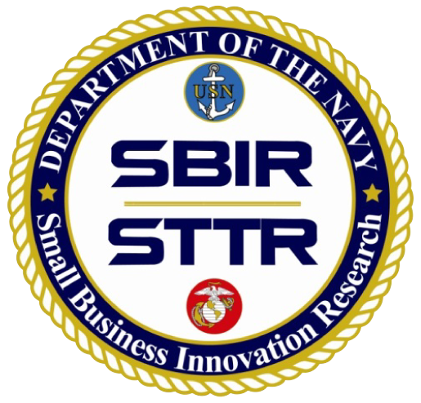
AN OFFERING IN THE BLUE CYBER SERIES
Cost-Effective Cybersecurity
Presented by Dr. Paul Shaw
Defense Acquisition University Professor
21 February 2023
#25 IN THE BLUE CYBER EDUCATION SERIES
Notes:
I’d like to introduce Dr. Paul Shaw. Dr. Shaw is a:
Defense Acquisition University Professor of Cybersecurity
Doctor of Science in Cybersecurity
five Master’s Degrees
and BS Ocean Engineering (US Naval Academy).
Numerous Professional Certifications
Former Department of the Navy Civilian
IT Technical Authority for Department of the Navy
Retired Navy Captain with 30 years of commissioned service
Navy senior leadership positions including Chief of Staff
Civilian experience as: President of a Start-Up company and CIO

Slide 2
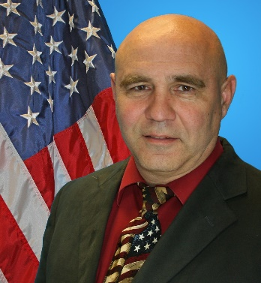
Cost Effective Cybersecurity
Dr. Paul Shaw
Professor, Cybersecurity
Defense Acquisition University (DAU)

Slide 3
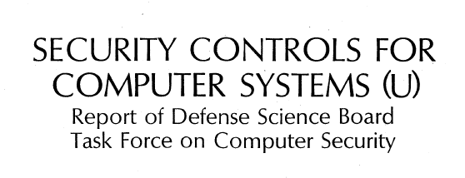
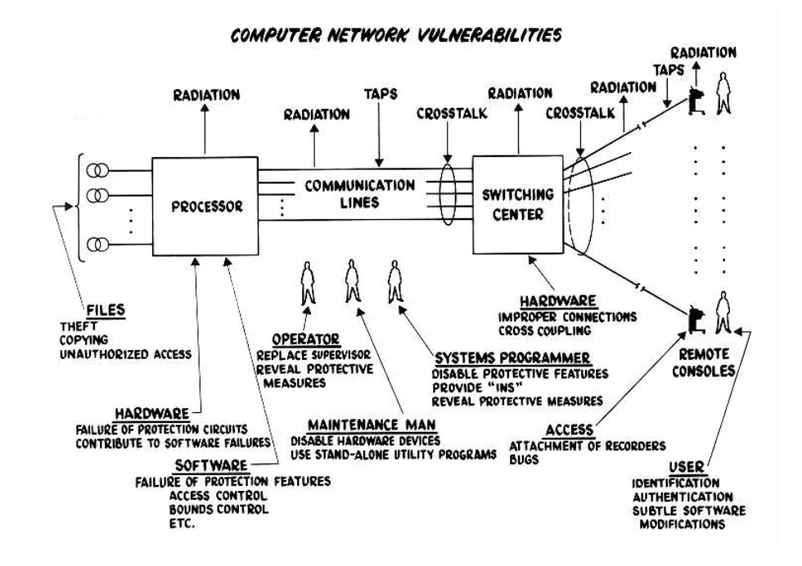

Computer Network Vulnerabilities
This diagram is from a DoD Study by Rand (also known as the Ware Report).
Does anyone know when this Report was published?
Defined threats are to the Data, Software, Hardware,
Personnel Access, Transmission, Endpoints, and the
Supply Chain
(p. 6)
https://csrc.nist.gov/csrc/media/publications/conference-paper/1998/10/08/proceedings-of-the-21st-nissc-1998/documents/early-cs-papers/ware70.pdf
13

Slide 4

State of Cybersecurity
“Of the approximately 347,000 manufacturers in the United States, 99% are small and medium-sized manufacturers, yet more than 50% lack basic cyber controls. An assessment by Bureau of Industry and Security illustrated the cybersecurity vulnerability of small manufacturers. The survey of over 9,000 “classified contract facilities” documented that 6,650 small facilities lagged medium and large firms across a broad range of 20 cybersecurity measures. It also found that fewer than half of the small firms had cybersecurity measures in place.” (p. 87 – 88)
https://media.defense.gov/2018/Oct/05/2002048904/-1/-1/1/ASSESSING-AND-STRENGTHENING-THE-MANUFACTURING-AND%20DEFENSE-INDUSTRIAL-BASE-AND-SUPPLY-CHAIN-RESILIENCY.PDF
13

Slide 5
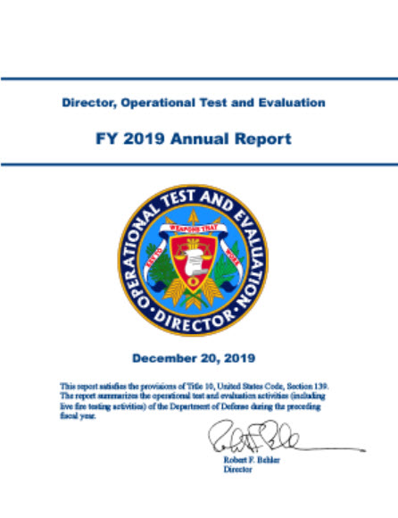
DoD T&E Annual Reports to Congress
Breaches of Contractors Give Advantage to Adversary.
“Breaches of cleared defense contractors provide adversaries with information that enables the development of cutting-edge weapons to be used against us, paves the way for cyber-attacks that could compromise critical DOD missions, and degrades our technical and commercial advantages.
DOT&E analyzed past breaches of defense contractors for several major programs and found that these breaches exposed extensive information that empowers our adversaries to degrade key DoD systems and missions. DOT&E also observed several supply-chain table top exercises where significant efforts were being implemented to help shield critical design information and software from adversaries. Efforts such as these should be implemented for all critical programs, and operational assessments and monitoring of contractor networks, tools, facilities, and software factories should become routine for critical programs.” (DOT&E FY19 Annual Report, p. 230)
https://www.dote.osd.mil/annualreport/

Slide 6
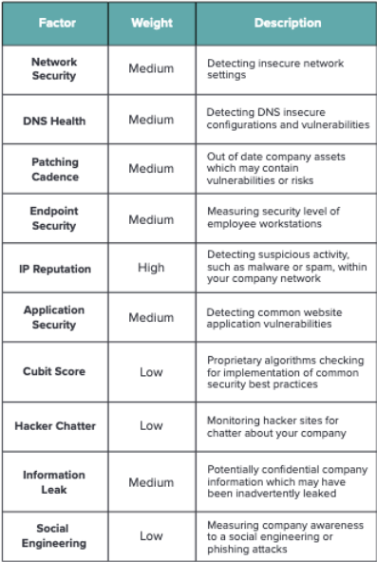
Potential Impact
“The protection of unclassified federal information in nonfederal systems and organizations is dependent on the federal government providing a disciplined and structured process for identifying the different types of information that are routinely used by federal agencies.” NIST 171 r1, p. 1
The security requirements described in this publication have been developed based on three fundamental assumptions:
Statutory and regulatory requirements for the protection of CUI are consistent, whether such information resides in federal systems or nonfederal systems including the environments in which those systems operate;
Safeguards implemented to protect CUI are consistent in both federal and nonfederal systems and organizations; and
The confidentiality impact value for CUI is no less than moderate in accordance with Federal Information Processing Standards (FIPS) Publication 199.
NIST 171 R 1, p. 5
https://securityscorecard.com/blog/securityscorecard-10-risk-factors-explained

Slide 7
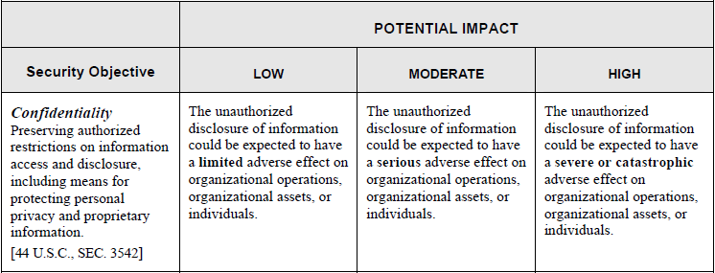
Potential Impact
“With regard to federal information systems, requirements in the federal regulation for protecting CUI at the moderate confidentiality impact level will be based on applicable policies established by OMB and applicable government wide standards and guidelines issued by NIST.” NIST 171 r1, p. v
FIPS 199, p. 6

Slide 8
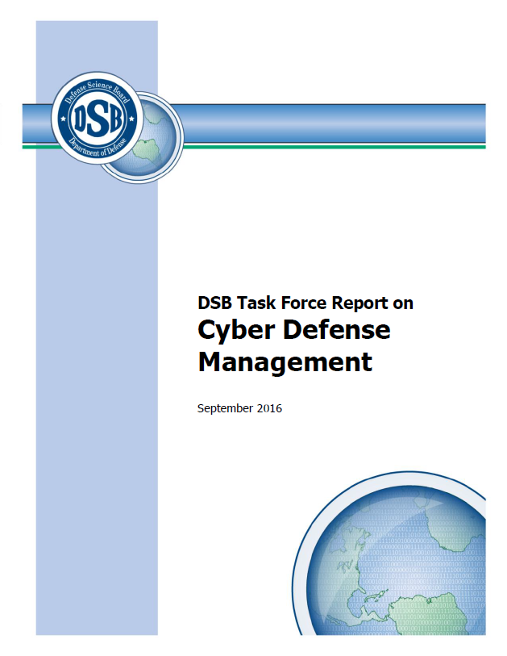
Basic CYBER Investments
“One of the most important steps for improving the United States’ overall cybersecurity posture is for companies to prioritize the networks and data that they must protect and to invest in improving their own cybersecurity. While the U.S. government must prepare to defend the country against the most dangerous attacks, the majority of intrusions can be stopped through relatively basic cybersecurity investments that companies can and must make themselves. ” (p. 5)
https://dsb.cto.mil/reports/2010s/Cyber_Defense_Management.pdf

Slide 9
DoD T&E Report
Breaches of Contractors Give Advantage to Adversary.
“Breaches of cleared defense contractors provide adversaries with information that enables the development of cutting-edge weapons to be used against us, paves the way for cyber-attacks that could compromise critical DOD missions, and degrades our technical and commercial advantages.
DOT&E analyzed past breaches of defense contractors for several major programs and found that these breaches exposed extensive information that empowers our adversaries to degrade key DOD systems and missions. DOT&E also observed several supply-chain table top exercises where significant efforts were being implemented to help shield critical design information and software from adversaries. Efforts such as these should be implemented for all critical programs, and operational assessments and monitoring of contractor networks, tools, facilities, and software factories should become routine for critical programs.” (DOT&E FY19 Annual Report, p. 230)
https://www.dote.osd.mil/annualreport/

Slide 10
Your Environment
(p. 4)
https://www.sans.org/white-papers/39105/

Slide 11
Implementing Cybersecurity
“As a certified auditor, Sera-Brynn has an inside look at how defense contractors are really doing when it comes to implementing cybersecurity acquisition clauses.” (p. 2)
Key Findings:
“Of the companies assessed:
- Zero companies were 100% compliant.
- On average companies implemented only 39% of the controls.
- 61% of the controls were either not implemented or only partially implemented.
- Large companies, on average, successfully implemented nearly 60% of the controls.
- Small to mid-sized companies, on average, successfully implemented 34% of the controls.
- Over 80% of companies assessed failed to implement 16 specific controls.” (p. 2 – 3)”
(p. 39)
https://sera-brynn.com/wp-content/uploads/2019/05/Reality_Check_DFARS_2019.pdf

Slide 12
Poor Systems Engineering
“Poor system security engineering is very difficult to mitigate by overlaying security controls, whereas security controls overlaid on a sound, secure design can be quite effective. For systems that are fielded and no longer in production, design changes to improve cybersecurity generally necessitate a modification program and can be cost-prohibitive. Most Air Force systems reside in this “legacy” phase. It is especially important in this phase that a mission assurance perspective be adopted that examines the full spectrum of options for cybersecurity, including after-design protective measures, changes in operational procedures, and modifications, if necessary and affordable.” (Rand, p. 8)
https://www.rand.org/pubs/research_reports/RR1007.html

Slide 13
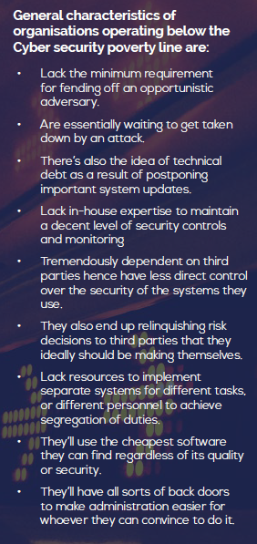
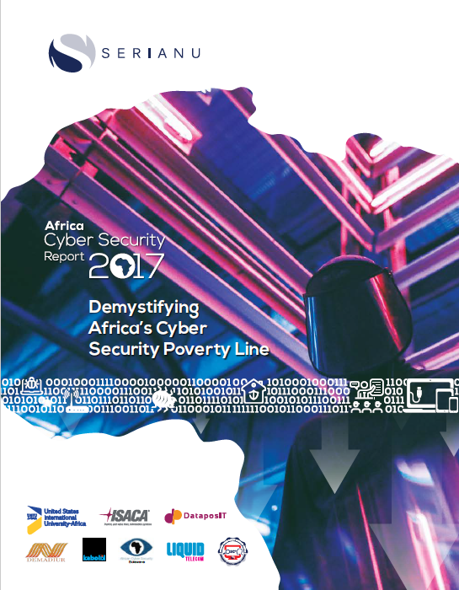
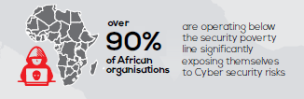
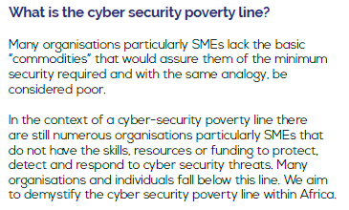
Cybersecurity Poverty Line
Vulnerable to
opportunistic attacker
Reactive response to attacks
(p. 11)
Postpones system
updates
- Africa > 90%
below poverty
line
- Would you be
below the
cybersecurity
poverty line?
Lacks expertise to
maintain security controls
Dependent upon
3rd parties for security
Relinquishes risk
decisions to third parties
Lacks segmentation of duties
Uses cheapest SW,
regardless of security
Allows back doors to easy administrator tasks
(p. 10)
(p. 9)

Slide 14
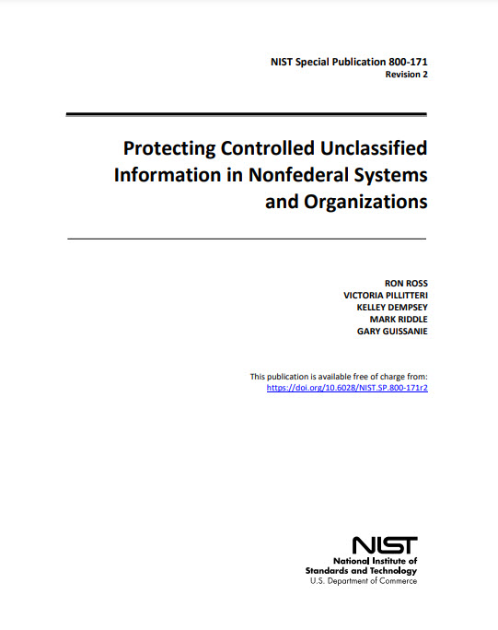
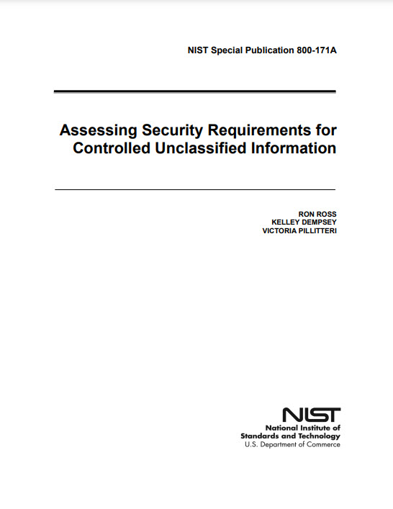
NIST 800-171 & NIST 800-171A
https://nvlpubs.nist.gov/nistpubs/SpecialPublications/NIST.SP.800-171r2.pdf
https://nvlpubs.nist.gov/nistpubs/SpecialPublications/NIST.SP.800-171A.pdf

Slide 15
How are you doing
Cyber Hygiene
Security Controls
Cyber Hardening
Architecture
Boundaries and Segmentation
Resilience
Other Security Techniques

Slide 16
What Makes Business Sense
How much and how often does your company need access to the sensitive information?
  Best Practice: The fewer people and systems with access to sensitive information – generally the lower the cost and complexity of defense.
Do you have the ability to change the architecture of your network?
  Best Practice: If limited ability to change your network architecture/design, you will gravitate to either an isolated network or an outsourced network.
Do you anticipate having either classified or highly sensitive unclassified information on your premise?
  Best Practices: If you have to change to a higher threat level, you may need to redesign your network. If your facility is cleared for classified, it might be cheaper to put your highly sensitive unclassified information on the classified network.

Slide 17
Business Decision
How much & often does your company need access to the sensitive information?
Only a few people need occasional access
Many people need regular access
Do you have the ability to change the architecture of your network?
You have the ability to change your network architecture
Network design is optimized for systems like an ERP or specialized systems
Do you anticipate having either classified or highly sensitive unclassified information on your premise?
My CUI is mostly likely at a moderate Impact
My CUI could easily become highly sensitive

Slide 18
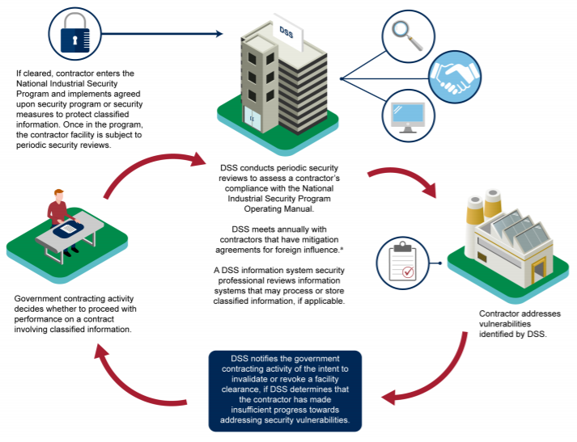
Cleared for Classified
When a site goes through the Cleared for Classified process – they have an approved transmission means, with acceptable storage, cleared personnel accessing the resources, are validated externally for set-up/operations, and are periodically audited by an external agency

Slide 19
Best Practice
A best practice for small businesses to limit investment cost is to limit sensitive unclassified information to a portion of their network or an enclave.
A “DIB contractor can achieve a specific CMMC level for its entire enterprise network or particular segment(s) or enclave(s), depending upon where the information to be protected is processed, stored, or transmitted.”
https://www.federalregister.gov/documents/2020/09/29/2020-21123/defense-federal-acquisition-regulation-supplement-assessing-contractor-implementation-of

Slide 20
Cost Effective Security Considerations
Transmission – Accepted secure means of transmission. Objective is to minimize monitoring costs and minimize the threat’s ability to compromise the confidentiality of the sensitive information.
Storage – Have a layered defense. Easy option is store as cyphertext and storage device has access controls. If storage is of cyphertext – it is not CUI until converted back to plaintext. Need to have ways of monitoring access to storage.
Access and Use/Modification – Minimize the number of devices and people with access. Do not retain CUI on the device, only on approved storage devices. As the device for access and use/modification are endpoints – best to use limited purpose and dedicated devices.
Monitoring – Skills for monitoring can widely vary. If your personnel need extensive analytical skills for log and threat analysis, costs can become very expensive, very quickly. Change in capability of the threat can dramatically increase your costs. Implemented security controls can easily follow S-cost curves (with additional incremental gains in capability coming at significant cost increases).
13

Slide 21
Choosing Between Designs
Questions to Work Through as a Business
How much and how often does your company need access to the sensitive information?
Do you have the ability to change the architecture of your network?
Do you anticipate having either classified or highly sensitive unclassified information on your premise?
Connected Network
Outsourced Network
(Cloud as an example)
Isolated Assets
Still have to transport Sensitive Information to network securely
Could add a burden to your people’s work processes
Guard against insider threat
Connectivity to sensitive information, brings burden to increased attack surface
Need much better threat monitoring and vulnerability assessment – more capable analysts
External threat, insider threat, and supply chain threat.
Dependent upon someone else and if contracted correctly
Leverage of other’s capabilities – monitoring, threat analysis, vulnerability analysis
Incident response can be a big deal

Slide 22
Choices of Design
Isolated Assets
Connected Network
Outsourced Network
(Cloud as an example)
Isolated (Air Gapped)
Controlled Access w/ Controls
Onsite Network w/NIST 800-171/172
Security Requirements & Threat Service
Outsourced IT & Threat Service
Advantages:
- Lower cost and faster to implement
- Requires less skill to manage
- Easier audit requirements
Disadvantages:
- Still susceptible to insider threat
- Could restrict business operations
- Over-confidence for air gap
Advantages:
- Better alignment with business ops
- Easier to manage customer interface
- Some proven designs are effective (such as CMTC Stop Light Architecture)
Disadvantages:
- Requires extremely capable staff
- Costs of implementation and audit increase dramatically
- Increased probability of compromise, especially if threat changes
Advantages:
- Leverage of provider’s security
- Situational awareness and threat services
- Costs can be reduced
Disadvantages:
- Trust in provider required
- Third party risk
- Use of services accessible to public

Slide 23
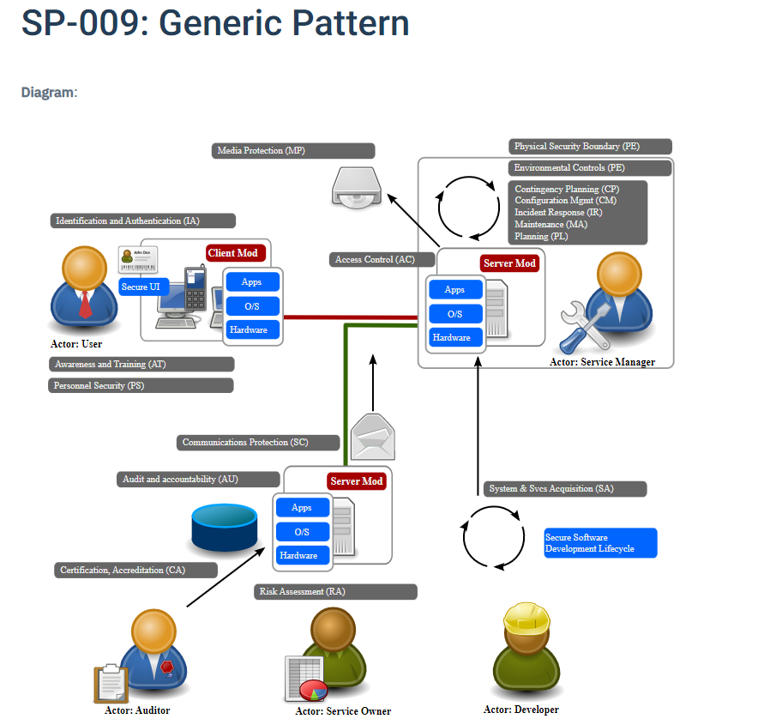
Architecture – Generic Pattern
“Description: The intention of this pattern is to show how the major control families apply to the computing environment. It aims to help familiarize people with the control families, and can provide a useful basis for thinking about security problems. This pattern can be used as the basis for other patterns. Users must authenticate in some manner to the systems they utilize. Server resources are managed to meet service level agreements. New services are periodically released into the environment. Existing services are maintained and decommissioned.
Assumptions: All computing systems are accessed from some form of user interface to a client. The client can connect to resources provided by a host across some form of network. Hosts can act as clients and servers to communicate. This model echoes the original design goals of TCP/IP where the intelligence is placed into the end point, and application layer of the network stack, and the network simply transfers data packets.”
Example of a self contained Network
https://www.opensecurityarchitecture.org/cms/library/patternlandscape/236-0802pattern009

Slide 24
Isolated Assets for Access & Storage
Provided as an example
Transmission - CD ROMs that are sent through the US Mail - double wrapped and appropriately marked. All data on the CD ROM are cyphertext. CD ROMs are destroyed after USPS receipt and cyphertext transferred to commercially bought AES 256-bit hardware encrypted hard drives. Different mail package for encryption keys.
Storage - Cyphertext stored on specific purpose AES 256-bit hardware encrypted hard drives (or encrypted thumb drives). One AES hard drive for CUI encrypted objects and one AES hard drive for crypto keys and downloaded transaction logs. The AES 256-bit hardware encrypted hard drive and any printed material will be stored at the SBIR's site in a sealed lockbox in a dedicated room (with no windows).
Access and Use - two air-gapped computers in controlled room that are appropriately monitored. Only authorized personnel are allowed in room. The computers use MFA to sign on. Two computers are connected by a cable – cable is to minimize tempest transmissions. One computer is for decrypting and viewing the cyphertext. The other computer is for recording logs and analyzing those logs. Both computers disable speakers and microphones to limit ultrasonic attacks and transmission. No retention of material is allowed on the viewing computer and all temporary files after viewing computer are purged. Other computer for logging required transactions and analyzing those transactions will periodically transfer files to the appropriate AES 256 bit encrypted hard drive. Both computers are periodically scanned for vulnerabilities and patched for updates of OS and critical software. Both computers use the DoD's STIG configurations for software and OS. All changes or updates of the CUI is done on those computers, stored on the AES 256-bit hard drives, and transmitted back to the customer as cyphertext with secure transmission.
Monitoring – Access to room and logs of viewing computer are analyzed. Provide validation that when cyphertext became plaintext (now is CUI) – that no retention on viewing computer and temporary files deleted. Need to prove that encryption keys are safely managed and not easily accessible with access to viewing computer.
13

Slide 25
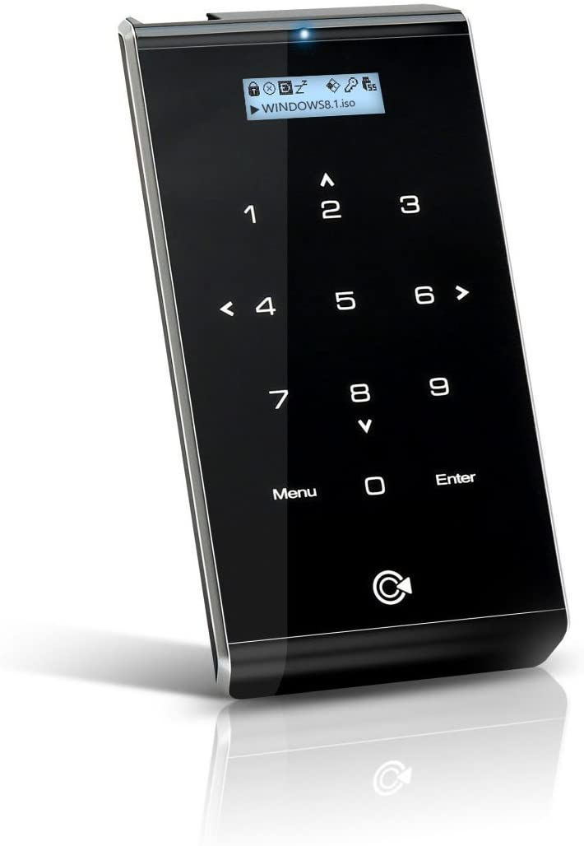
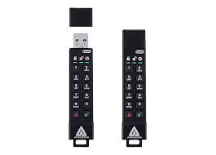
Secure Storage
Store as Cyphertext – not Plaintext on a device that encrypts stored objects. This a layered defense of cyphertext being stored securely on a device that limits access and provides another layer of defense.
Example - commercially bought AES 256-bit hardware encrypted hard drives and thumb drives
Note: the above images are purely representational and not an endorsement of a specific product

Slide 26
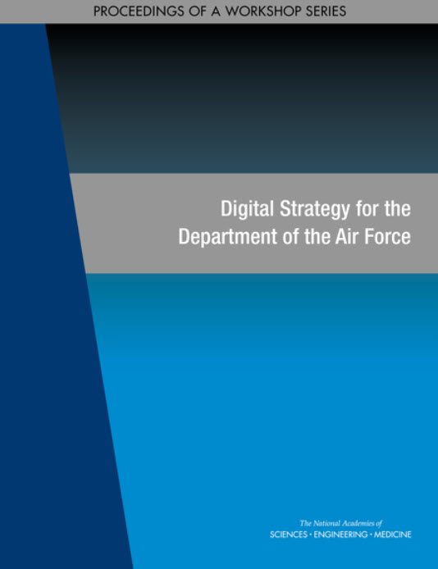
AF Digital Strategy
“Mr. Caron compared legacy networks, most of which are architected as flat networks, to Tootsie Roll Pops, with a “hard outer shell with a soft, gooey center”—once adversaries find an opening in the perimeter security, they can leverage vulnerabilities and gain full access. Many efforts have been made to prevent such breaches, but, referencing Frederick the Great, he said that “he who defends everything defends nothing.” He asserted that trying to protect all systems, applications, and data equally leads to a situation in which some are overprotected, others are under protected, and overall network functionality is constrained. Instead, the optimal approach to cybersecurity is to determine where protections are needed based on the sensitivity and associated risk of individual components.” (p. 48 -49)
https://nap.nationalacademies.org/catalog/26531/digital-strategy-for-the-department-of-the-air-force-proceedings
13

Slide 27
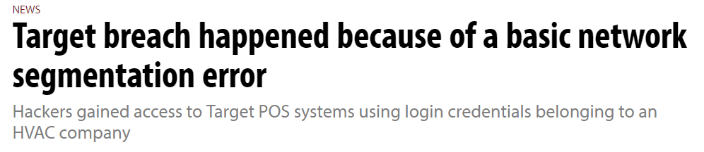
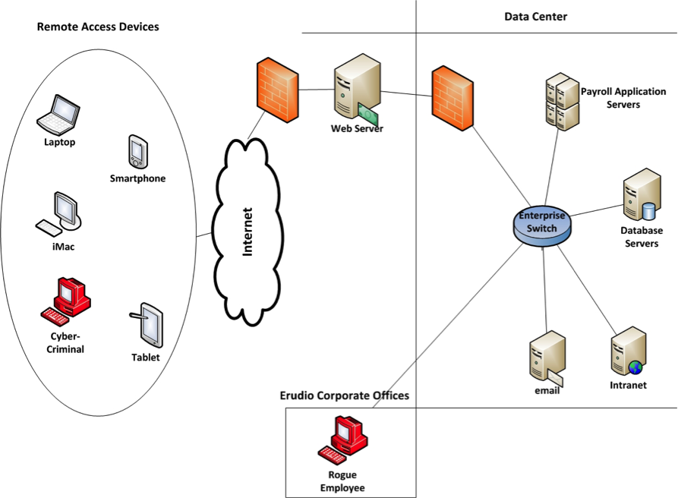
Architecture – flat network
Network connected to outside world
According to Krebs, sources close to the investigation said the attackers first gained access to Target's network on Nov. 15, 2013 with a username and password stolen from Fazio Mechanical Services, a Sharpsburg, Pa.-based company that specializes in providing refrigeration and HVAC systems for companies like Target.
Fazio apparently had access rights to Target's network for carrying out tasks like remotely monitoring energy consumption and temperatures at various stores.
The attackers leveraged the access provided by the Fazio credentials to move about undetected on Target's network and upload malware programs on the company's Point of Sale (POS) systems.
Available at http://www.computerworld.com/article/2487425/cybercrime-hacking/target-breach-happened-because-of`-a-basic-network-segmentation-error.html
Why a flat network is so common and extremely insecure
Simple to architect
Cheap to build
Easy to operate and maintain
Remote
What is the right balance between ease of use and security?

Slide 28
Flat Network = Bad
““Flat” networks allow an adversary to easily maneuver to any system connected to that network. Segment your networks into “subnetworks” to make it harder for an adversary to gain access to essential systems and equipment.”
https://www.dco.uscg.mil/Portals/9/DCO%20Documents/5p/CG-5PC/INV/Alerts/0619.pdf

Slide 29
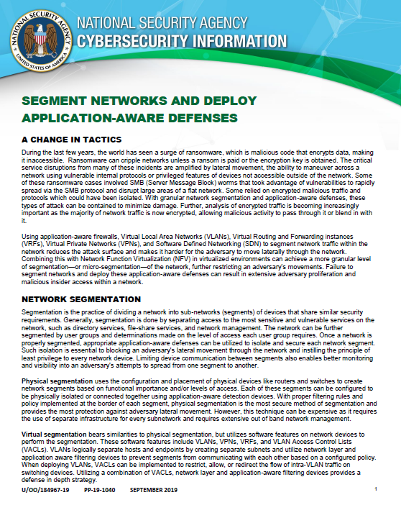
Segment Networks
“Segmentation is the practice of dividing a network into sub-networks (segments) of devices that share similar security requirements. Generally, segmentation is done by separating access to the most sensitive and vulnerable services on the network, such as directory services, file-share services, and network management. The network can be further segmented by user groups and determinations made on the level of access each user group requires. Once a network is properly segmented, appropriate application-aware defenses can be utilized to isolate and secure each network segment. Such isolation is essential to blocking an adversary’s lateral movement through the network and instilling the principle of least privilege to every network device. Limiting device communication between segments also enables better monitoring and visibility into an adversary’s attempts to spread from one segment to another.” (p. 1)
https://media.defense.gov/2019/Sep/09/2002180325/-1/-1/0/Segment%20Networks%20and%20Deploy%20Application%20Aware%20Defenses%20-%20Copy.pdf

Slide 30
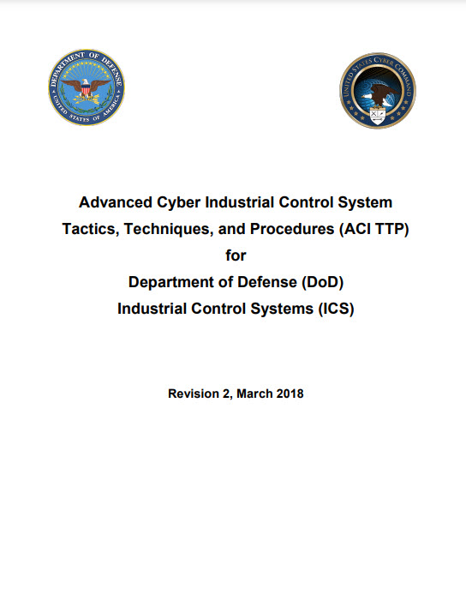
Segmentation Strategy
Creating a Segmentation Strategy
“a. The segmentation strategy is a documented process for understanding how your ICS assets could be separated during and after a cyber attack. Each ICS environment is unique, based on protocols, network architecture, physical locations, equipment,
software, and mission priorities.
b. The first step is to identify the commander’s mission priorities. These are the most critical processes that must remain operational.
c. The second step is to identify critical processes and dependencies. This includes identifying all of the assets that are required to keep the mission priorities operational.
d. The third step is to review the network architecture to identify logical points where segmentation could occur to contain infected assets or protect the ICS processes.
e. This document should be maintained with the continuity of operations and baseline documentation.” (p. H-1)
https://www.serdp-estcp.org/Tools-and-Training/Installation-Energy-and-Water/Cybersecurity/Resources-Tools-and-Publications/Resources-and-Tools-Files/DoD-Advanced-Cyber-Industrial-Control-System-Tactics-Techniques-and-Procedures-ACI-TTP

Slide 31
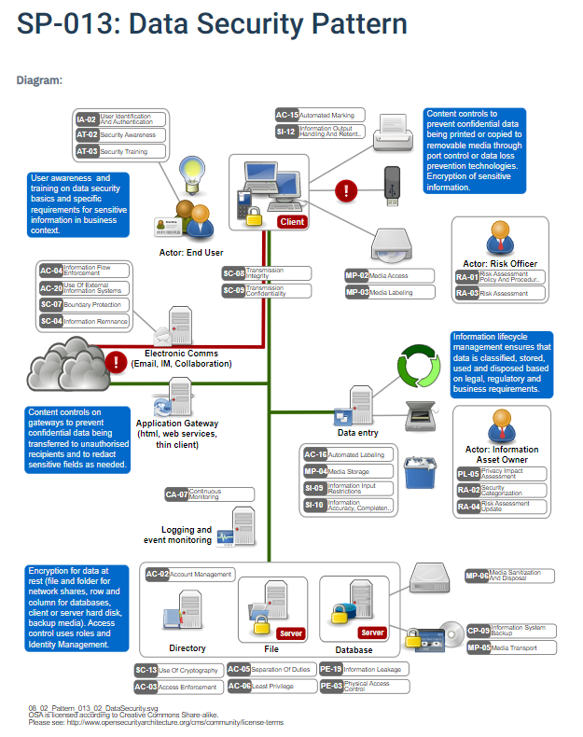
Architecture – Data Security
“A Data Classification scheme is often used to help understand which controls are needed for the data types processed by the organization. This scheme will be defined based on the legal, regulatory and business requirements that the organization must adhere. Common schemes used have 3 or 4 levels, including Public/Unclassified (e.g. Marketing materials), Internal Use (Information shared within the organization or with suppliers e.g. Intranet), Confidential/Private (Sensitive information e.g. Credit card details or Medical history), Secret (Market Sensitive Information e.g. Year-end results or Secret recipe for Coca-Cola).”
https://www.opensecurityarchitecture.org/cms/library/patternlandscape/259-pattern-data-security

Slide 32
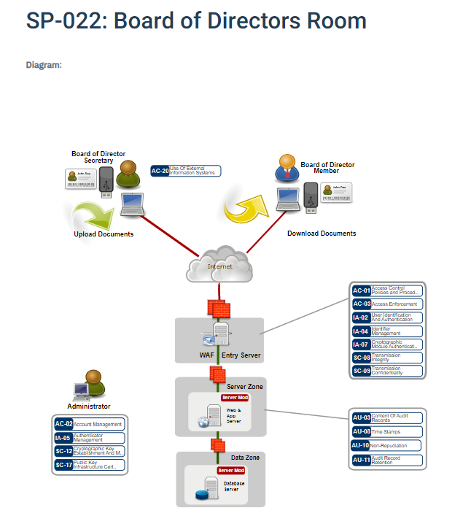
Architecture – Secure Access
“Synopsis: Board of Directors Room for reading highly confidential documents on an un-trusted computer.
Description: Board of Directors need access to meeting protocols, agenda and other highly confidential information. Any computer may be used, even un-trusted or compromised computers. The documents accessible are highly confidential and no traces of documents shall be found on computer. It shall not be possible to download the documents in clear text or to print the documents. Detailed audit functionality shows which user has read which document and when. All documents are stored in the PDF format.”
https://www.opensecurityarchitecture.org/cms/library/patternlandscape/292-pattern-board-room

Slide 33
Scenario 2: Connected Network
https://www.cmtc.com/cybersecurity
13

Slide 34
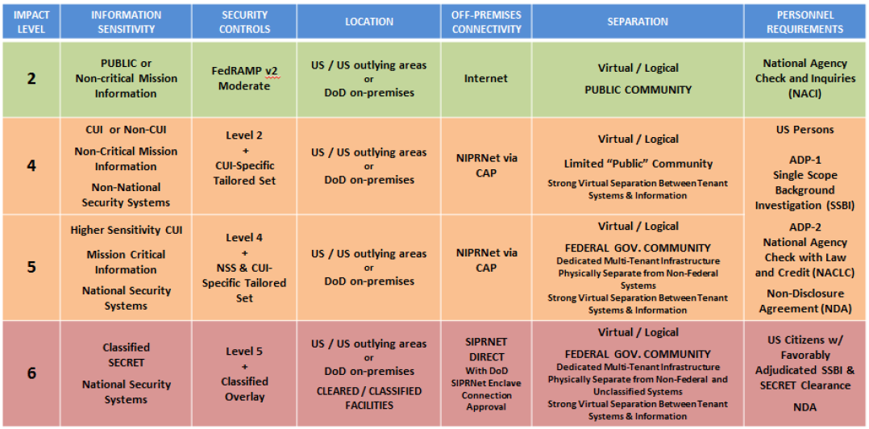
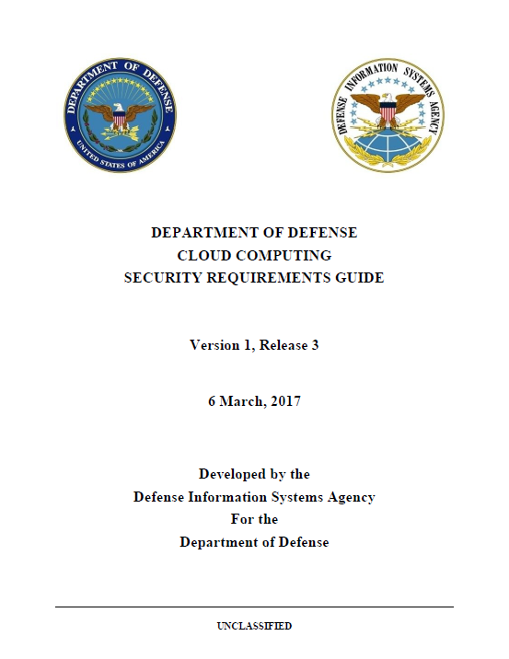
Scenario 3: Outsourced (Cloud) Networking
All DoD data is important, but not all data needs to be equally protected
Information Impact Levels (IILs) consider the potential impact should the confidentiality and integrity of the information be compromised
CUI is at least
IIL 4 or above!!
13

Slide 35
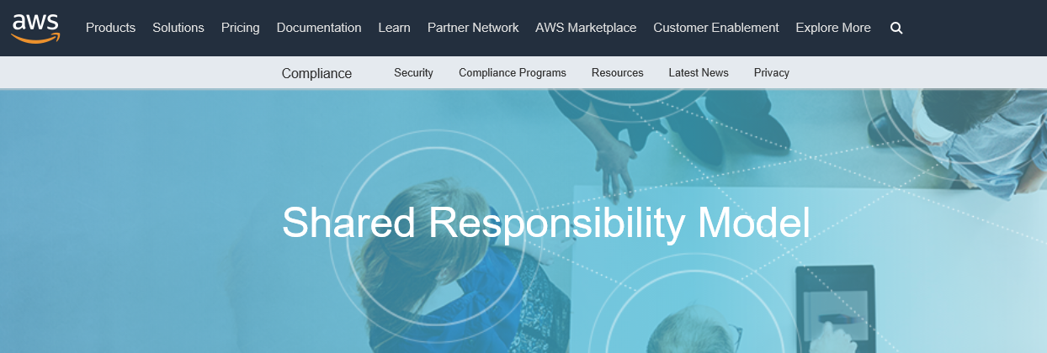
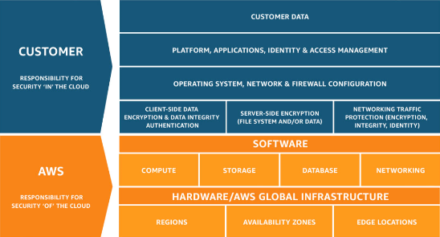
Shared Responsibility
https://aws.amazon.com/compliance/shared-responsibility-model/
“Security and Compliance is a shared responsibility between AWS and the customer. This shared model can help relieve the customer’s operational burden as AWS operates, manages and controls the components from the host operating system and virtualization layer down to the physical security of the facilities in which the service operates. The customer assumes responsibility and management of the guest operating system (including updates and security patches), other associated application software as well as the configuration of the AWS provided security group firewall. Customers should carefully consider the services they choose as their responsibilities vary depending on the services used, the integration of those services into their IT environment, and applicable laws and regulations. The nature of this shared responsibility also provides the flexibility and customer control that permits the deployment. As shown in the chart below, this differentiation of responsibility is commonly referred to as Security “of” the Cloud versus Security “in” the Cloud.”
…”This customer/AWS shared responsibility model also extends to IT controls. Just as the responsibility to operate the IT environment is shared between AWS and its customers, so is the management, operation and verification of IT controls shared. AWS can help relieve customer burden of operating controls by managing those controls associated with the physical infrastructure deployed in the AWS environment that may previously have been managed by the customer. As every customer is deployed differently in AWS, customers can take advantage of shifting management of certain IT controls to AWS which results in a (new) distributed control environment.”

Slide 36
Questions

Slide 37

Any Questions?
This briefing is not a substitute for reading the FAR and DFARS in your contract.
This presentation and other presentations in the Blue Cyber Educational Series and be found on the Blue Cyber webpage: https://www.safcn.af.mil/CISO/Small-Business-Cybersecurity-Information/
Please provide questions, feedback or if you just want to talk about your cyber security /data protection questions to Kelley.Kiernan@us.af.mil
  Daily Office Hours for answering/researching your questions about DAF Small Business cybersecurity and data protection!
  Every Tuesday, 1pm Eastern, dial in for the DON CISO Small Business Cybersecurity Ask-Me-Anything. Register at www.sbir.gov/events
Notes:
Here again is Kelley Kiernan’s email and a QR code which will take you to the Blue Cyber web page
We’ll pause here so you can capture that QR code if you want it
Thanks to our event planners, Pamela, Sarah and Brittany. (they will say thanks back )
And so long to you until next Tuesday when Kelley will be back and the topic will be the Protecting your IP at the February 28 Boot Camp
So long!

